Slide 1
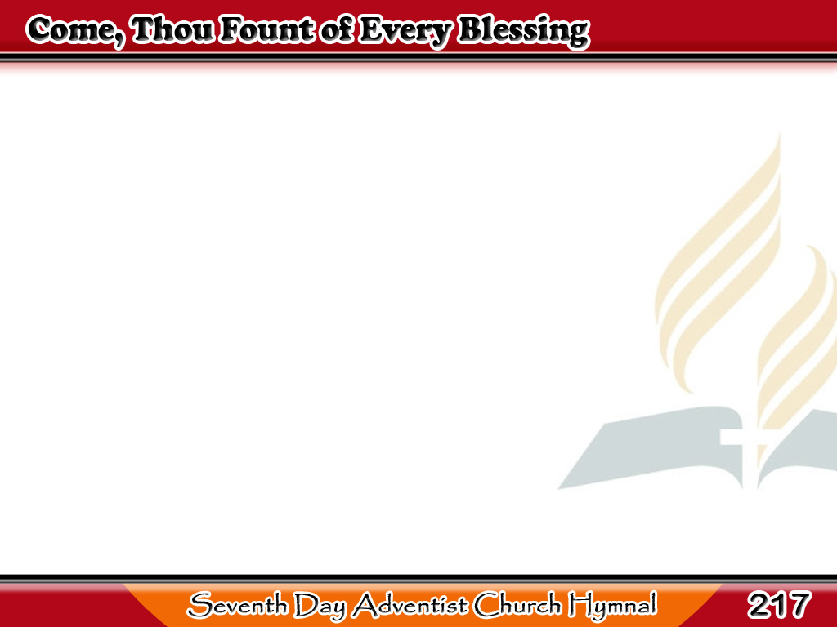
Ang Mahihinang Damdamin
Come, Thou Fount
of every blessing,
Tune my heart to sing Thy grace;
Streams of mercy, never ceasing,
Call for songs of loudest praise.
1/3

Slide 2
Ang Mahihinang Damdamin
Teach me ever to adore Thee,
May I shall Thy goodness prove,
While the hope of endless glory
Fills my heart with joy and love.
1/3

Slide 3
Ang Mahihinang Damdamin
Here I raise my Ebenezer,
Hither by Thy help I’ve come,
And I hope by Thy good pleasure
Safely to arrive at home.
2/3

Slide 4
Ang Mahihinang Damdamin
Jesus sought me when a stranger,
Wandering from the fold of God;
He to rescue me from danger
Interposed His precious blood.
2/3

Slide 5
Ang Mahihinang Damdamin
O, to grace how great a debtor
Daily I’m constrained to be!
Let Thy goodness, like a fetter,
Bind me closer still to Thee.
3/3

Slide 6
Ang Mahihinang Damdamin
Prone to wander, Lord, I feel it,
Prone to leave the God I love;
Here’s my heart O,
take and seal it;
Seal it for Thy courts above.
3/3

